Slide 1
Discrete Mathematics (I) Course Introduction
Instructor : Jeong Goo Kim
kimjg @ pusan.ac.kr
Note) Some open-source fonts, such as Naver Nanum fonts and Google Raleway fonts, are used in this slide. Download and Install them, if you see broken characters

Slide 2
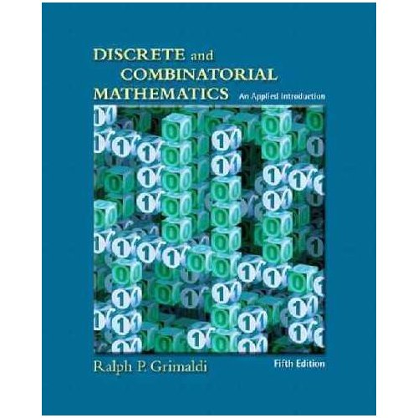
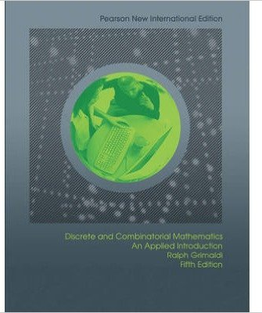
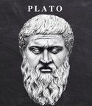
Course Info.
Discrete Mathematics (I)
Course Number : CB1501027, Mandatory Major, 3 Credits, Class #: 059
Class Hours : 15:00 ~ 16:15 (Tue. & Thu.)
Instructor : Jeong Goo Kim
kimjg@pusan.ac.kr, Office: 313-420, Tel: 510-3733
Office Hour: 13:50 ~ 14:50 Tuesday
Textbook
“Discrete and combinatorial mathematics ” (5th Ed), R.P. Grimaldi, 2004
Course Home Page: PLATO
PLATO : PNU smart platform for Learning, Advanced Teaching and Open Courseware
https://plato.pusan.ac.kr/course/view.php?id=140547

Slide 3
Weekly Schedule
활동사항 | 학습내용 | 주
 | Course Introduction / Principles of Counting | 1
 | Logic: truth table, equivalence | 2
 | Logic formal proof | 3
Homework #1 | Logic: Predicate Calculus | 4
Quiz1 | Sets: set operation, power set, induction | 5
 | Sets: inductive proof | 6
 | Relations: Cartesian product, composition, converse, matrix representation. | 7
Homework #2 | Functions: one-to-one, onto function composition, inverse Midterm Exam. | 8
 | Properties of relations | 9
 | Relations and directed graphs | 10
Homework #3 | Closures, cardinality | 11
Quiz2 | Equivalence Relations : equivalent classes partition, refinement | 12
 | Ordering Relations : poset | 13
Homework #4 | Ordering Relations : bounds, lattices | 14
 | Final Exam | 15

Slide 4
평가 (Grading Policy)
Final Exam. Schedule – June 15.
Points | Category
10% | Attendance
5% | Attitude/Presentation
20% | Homework
5% | Quiz
30% | Midterm Exam.
30% | Final Exam.
100% | Total

Slide 5
수학 (數學 Mathematics) - Wikipedia
Mathematics (from Greek "knowledge, study, learning") is the abstract study of topics encompassing quantity, structure, space, change and other properties; it has no generally accepted definition. (From Wikipedia)
Mathematicians seek out patterns and formulate new conjectures [추측].
Mathematicians resolve the truth or falsity of conjectures by mathematical proof [수학적 증명].
It has become customary to view mathematical research as establishing truth by rigorous deduction [연역] from appropriately chosen axioms [공리] and definitions [정의].
When those mathematical structures are good models of real phenomena, then mathematical reasoning can provide insight or predictions about nature.

Slide 6
Fields of Mathematics
Mathematics can, broadly speaking, be subdivided into the study of quantity, structure, space, and change.
Quantity - Arithmetic[산술]
Structure – Algebra[대수학]
Space - Geometry[기하학]
Change - Analysis[해석학]
In addition to these main concerns, there are also subdivisions dedicated to exploring links from the heart of mathematics to other fields: to logic [논리학], to set theory [집합론] (foundations[수학기초론]), to the empirical mathematics of the various sciences (applied mathematics[응용수학]), and more recently to the rigorous study of uncertainty.
Foundations and Philosophy
Pure Mathematics
[1] Quantity, [2] Structure, [3] Space, [4] Change
Applied Mathematics
Statistics and Other Decision Sciences
Computational Mathematics

Slide 7






Pure Mathematics
Quantity – Arithmetic [산술]
Structure – Algebra [대수학(代數學)]
Natural Numbers | Integers | Rational Numbers | Real Numbers | Complex Numbers
자연수 | 정수 | 유리수 | 실수 | 복소수
Combinatorics | Number Theory | Group Theory | Graph Theory | Order Theory
조합론 | 수론 | 군론 | 그래프 이론 | 순서론

Slide 8









Pure Mathematics
Space – Geometry [기하학 (幾何學)]
Change – Analysis [해석학 (解析學)]
Trigonometry | Differential Geometry | Topology | Fractal Geometry
삼각법/삼각함수 | 미분기하학 | 위상수학 | 프랙탈 기하학
Calculus | Vector Calculus | Differential Equations | Dynamical System | Chaos Theory
미적분학 | 벡터 미적분학 | 미분방정식 | 동역학계 | 혼돈이론

Slide 9




Foundations and Philosophy
수학 기초론
Mathematical Logic / Formal Logic | Set Theory | Category Theory | Theory of Computation
수리논리학 / 형식논리학 | 집합론 | 범주론 | 계산이론
$$p⟹q$$

Slide 10










Applied Mathematics
Statistics and Decision Sciences, Computational Mathematics
Probability Theory | Statistics | Numerical Analysis | Optimization | Mathematical Finance
확률론 | 통계학 | 수치해석 | 최적화 이론 | 금융수학
Game Theory | Control Theory | Cryptography | Mathematical Physics | Fluid Dynamics
게임 이론 | 제어 이론 | 암호학 | 수리물리학 | 유체역학

Slide 11
이산수학(離散數學, Discrete Mathematics)
이산수학은 이산적인 수학 구조에 대해 연구하는 학문으로, 연속되지 않는 공간을 다룬다. 유한수학이라고도 하며, 전산학적인 측면을 강조할 때는 전산수학이라고도 한다. 주로 정수, 유한 그래프, 형식 언어 같이 가산 집합에 속하는 개념을 다룬다. 이산수학은 전산학의 기초가 되는데, 이것은 컴퓨터에서 다루는 자료형이 이산적이라는 것에서 기인한다. 이산수학에서 나온 개념과 기호는 컴퓨터 알고리즘과 프로그래밍 언어의 문제나 대상들을 연구하는 데 유용하다.
이산수학의 주제
조합론 : Combinatorics
논리학 : Logic
집합론 : Set Theory
관계론 : Relation Algebra
그래프 이론 : Graph Theory
수론 : Number Theory
암호학 : Cryptography
오토마타 : Automata Theory
離散
連續
Discrete
Continuous
Digital
Analog
Notes:
http://www.veritas-a.com/news/articleView.html?idxno=143114
http://m.edu.donga.com/news/view.php?at_no=20190215144546765967
http://news.mit.edu/2018/mit-reshapes-itself-stephen-schwarzman-college-of-computing-1015
구분 2015년 2016년 2017년 2018년
부전공 1 9 18 35
복수전공 1 11 13 24
연계전공 43 46
계 2 20 74 105

